Slide 1
Wind Turbine Project
funding provided by

Slide 2
Wind Turbine Project
Wind Turbine Project
University at Buffalo
Barry Smith, PI
Rahul Rai, Co-PI
J. Neil Otte, UB Project Manager
Ruoyu Yang, student
Munira binti Mohd Ali, student
Binbin Zhang, student
Air Force Research Laboratory
Clare Paul, Expert Consultant

Slide 3
Wind Turbine Project
Goals of Wind Turbine Project
1. Using existing ontologies and an existing dataset, build an application ontology and use it to create an RDF knowledge graph.
2. Query this knowledge graph to aid a materials engineer in a material selection process.

Slide 4
Wind Turbine Project
Ontologies are tools for data integration. They consist of a taxonomy of classes linked by subclasses relations, a list of relations that hold among instances of those classes, and axioms or rules that pertain to instances of the classes.
Knowledge Graph: a knowledge base taking the form of a graph. Our knowledge graph is in RDF (rich descriptive framework) format. It was generated using an existing dataset and an ontology.

Slide 5
Wind Turbine Project
Upper Ontologies: An ontology that represents entities that are common across all domains. These include: spaces, times, matter, properties, etc.
Domain Ontologies: An ontology that represents entities within a specific domain, such as physics or immunology.
Application Ontologies: An ontology that includes highly specific entities whose representation is necessary for some particular purpose.

Slide 6
Wind Turbine Project
Top-Level Ontology
Basic Formal Ontology
Domain Ontology
Common Core Ontologies
Product Life Cycle Ontologies
Application Ontology
Wind Turbine Ontology

Slide 7
Basic Formal Ontology
BFO
The Common Core Ontologies Suite
CCO
Extended Relation Ontology
Geospatial Ontology
Time Ontology
Information Entity Ontology
Event Ontology
Quality Ontology
Agent Ontology
Artifact Ontology
Units of Measure Ontology
Currency Unit Ontology
Modal Relation Ontology
All Core Ontology
Notes:
What we are presently missing here is an end-of-life domain ontology that would cover disposal and recycling.

Slide 8
Basic Formal Ontology
BFO
The Product Life Cycle Ontology Suite
CCO
Extended Relation Ontology
PLC
Geospatial Ontology
Time Ontology
Information Entity Ontology
Event Ontology
Quality Ontology
Agent Ontology
Artifact Ontology
Units of Measure Ontology
Currency Unit Ontology
Modal Relation Ontology
All Core Ontology
All CHAMP Ontology
Services Ontology
Design Ontology
Testing Processes Ontology
Maintenance Process Ontology
Manufacturing Processes Ontology
Machine and Tool Ontology
Commercial Entities Ontology
Product Life Cycle Ontology
Notes:
What we are presently missing here is an end-of-life domain ontology that would cover disposal and recycling.

Slide 9
The Industrial Ontologies Foundry (IOF)
Workshop, July 18th and 19th
Buffalo, NY
Notes:
What we are presently missing here is an end-of-life domain ontology that would cover disposal and recycling.

Slide 10
Wind Turbine Project
Use Case
As a wind turbine blade engineer, I want to use machine learning to recommend optimum composite material designs so that I can deliver maximum performance within environmental constraints.

Slide 11
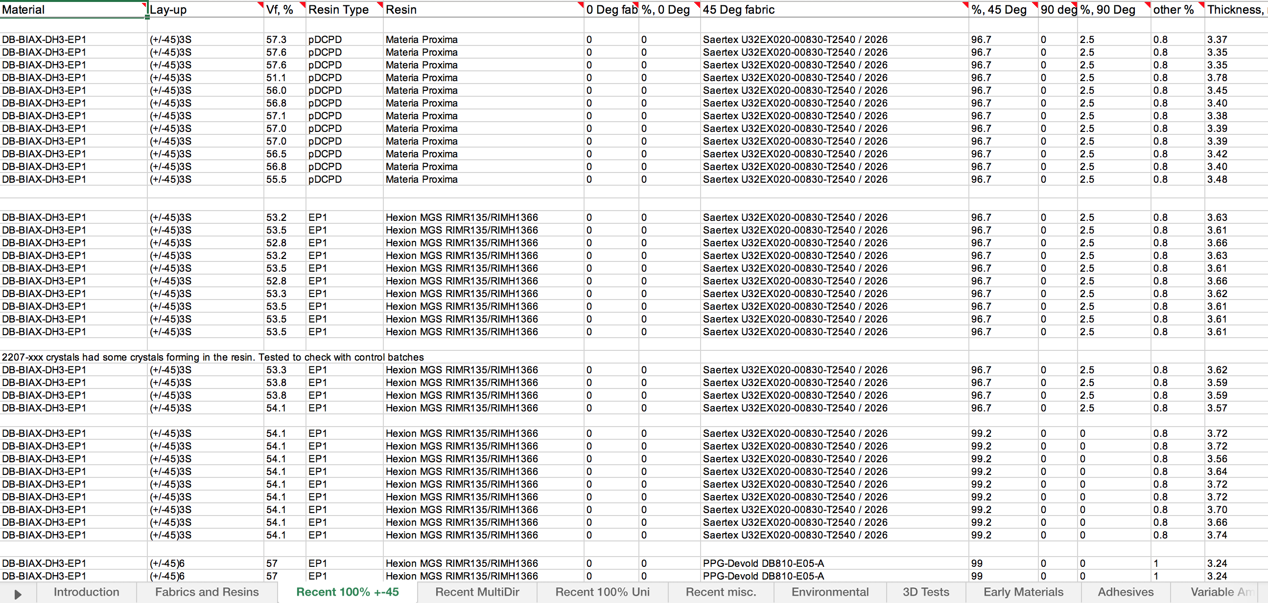
Wind Turbine Project
The database for wind turbine blade materials data at Sandia National Lab at Montana State University is available here:
http://energy.sandia.gov/energy/renewable-energy/water-power/technology-development/advanced-materials/mhk-materials-database/
Notes:
The database consists of several spreadsheets in Microsoft Excel which contain the results of the Sandia sponsored “Fatigue of Composite Materials for Wind Blades” testing and research program at MSU. Materials are either fabricated at MSU or provided by industry. Contractor Reports and conference publications listed at the end of this section include test methods, processing, graphical representations of the data, fits to various models, and discussion of trends and implications. This version contains tests performed between 3/14/1990 and 3/7/2016

Slide 12
Blade Design Parameter
Beam Cross Section Area
Solid Rectangle Beam Cross Section Area
I-Beam Cross Section Area
Hollow Rectangle Beam Cross Section Area
Hollow Circle Beam Cross Section Area
Beam Length
Beam Width
Beam Height
Beam Inside Width
Beam Inside Height
Flange Thickness
Web Thickness
Radius
Inner Radius
Moment of Inertia X
Solid Rectangle Beam Moment of Inertia X
I-Beam Moment of Inertia X
Hollow Rectangle Beam Moment of Inertia X
Hollow Circle Beam Moment of Inertia X
Beam Maximum Deflection
Moment of Inertia Y
Solid Rectangle Beam Moment of Inertia Y
I-Beam Moment of Inertia Y
Hollow Rectangle Beam Moment of Inertia Y
Hollow Circle Beam Moment of Inertia Y
Process Parameter
Beam Tip Uniform Load
Beam Root Uniform Load
Material Parameter
Modulus of Elasticity

Slide 13
Wind Turbine Project
Material Selection Analysis Goal
To realize, based on some key performance parameters (KPP), some key design objective

Slide 14
Wind Turbine Project
Material Selection Analysis Goal
Key performance parameters (KPP): Material type, fiber direction, and the specimen’s dimensions …
Key design objective: Find the variation of the maximum strain percentage relative to the load cycle time applied to the specimen.

Slide 15
Wind Turbine Project
Method in Four Steps
Complete an application ontology for the dataset, reusing existing work.
Create an RDF knowledge graph (map SNL dataset to the ontology using SPARQL Motion from TopBraid Composer).
Place the knowledge graph on a server running Apache Jena.
Create SPARQL queries of interest and use them to query the knowledge graph.

Slide 16
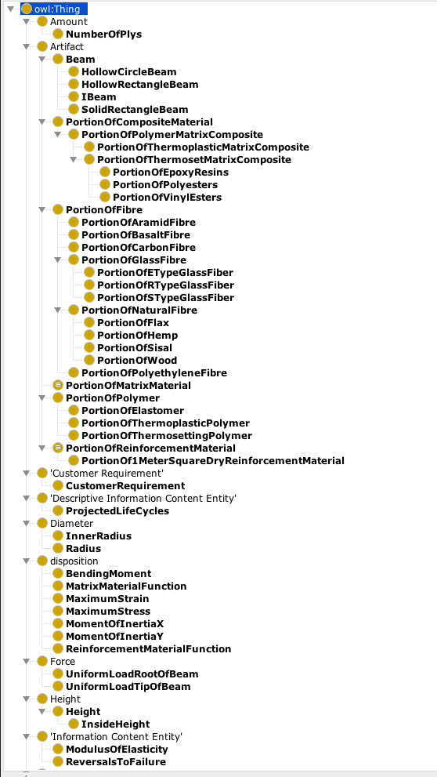
Wind Turbine Blade Material Analysis Ontology
“WTBA.ttl”

Slide 17
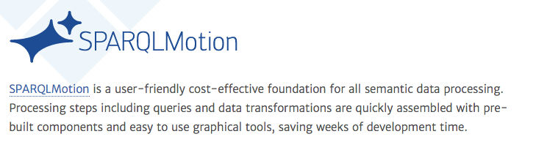
Wind Turbine Project
TopBraid Composer

Slide 18
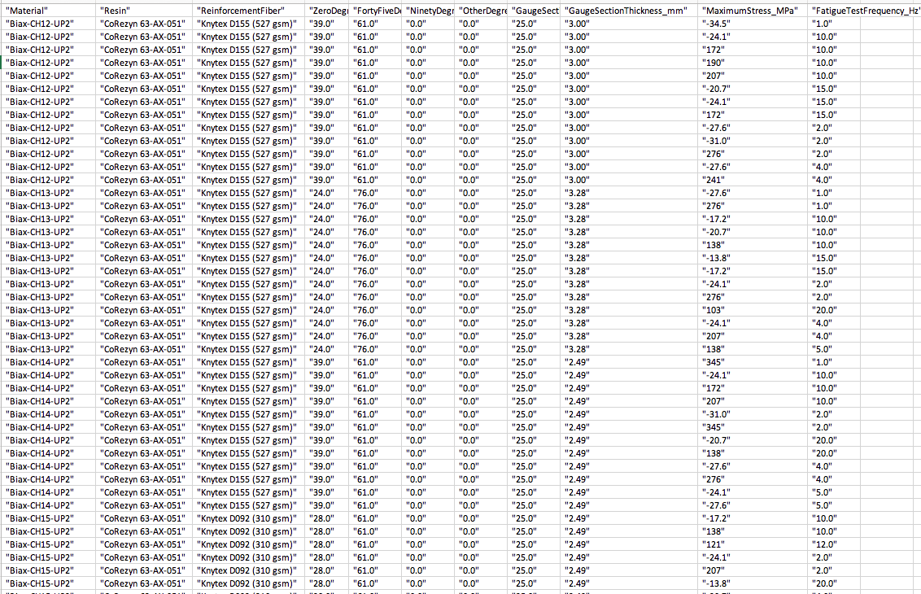
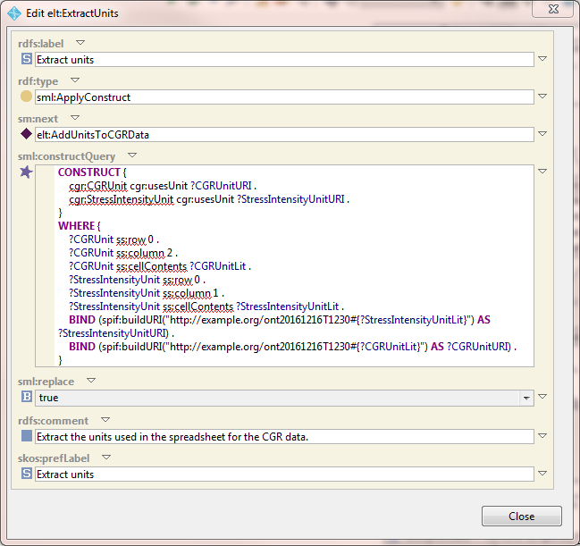
Wind Turbine Project
“WTBA.ttl”
RDF files to form part of the Sandia Knowledge Graph
Notes:
SPARQL construct queries take the tabular data from the original data set, and using classes and relations from our ontology file, construct sets of triples that are returned as an RDF file.

Slide 19
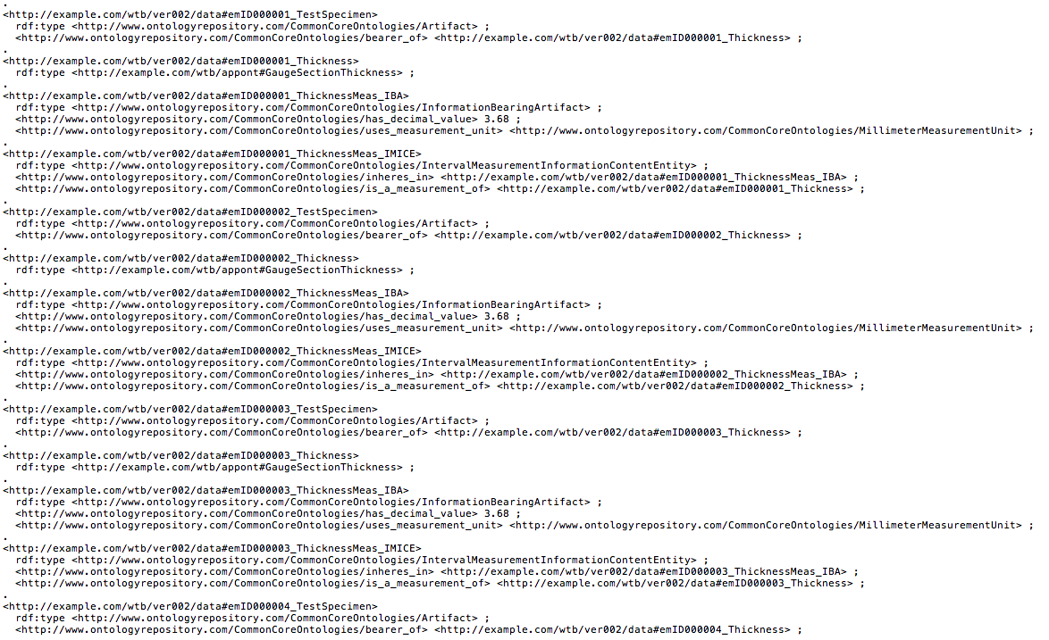
Wind Turbine Project
Sample of an RDF File
from “EarlyMatlAndEnv06_GaugeSectionThickness.ttl”
7125 triples

Slide 20

Wind Turbine Project

Slide 21
Test Method
Wind Turbine Project
Tensile fatigue testing on the specimen that has the following parameter:
Specimen’s material properties (Material name, Composition of Resin and Reinforcement Fiber with it’s orientation degree percentage, Modulus of Elasticity)
Specimen’s dimension (Gage Width and Gage Thickness)
Constant load rate by varying the Frequency (Hz) and the Maximum Stress

Slide 22
SPARQL Query 1
Wind Turbine Project
According to the material type, material properties, and the dimensions of the test specimen, find the frequency (HZ) variation and maximum stress (mpa) applied to the specimen.
In addition:
Query 1a: Filter the search by the material’s layer structure
Query 1b: Filter the search by the material’s name
Filters allow us to order the results against a variable of interest.

Slide 23
Query 1
PREFIX emae06: <http://example.com/emae06#>
PREFIX xsd: <http://www.w3.org/2001/XMLSchema#>
SELECT DISTINCT ?Material ?Resin ?ReinforcementFiber ?ZeroDegreeDirectionFiber_pct ?FortyFiveDegreeDirectionFiber_pct ?NinetyDegreeDirectionFiber_pct ?OtherDegreeDirectionFiber_pct ?GaugeSectionWidth_mm ?GaugeSectionThickness_mm ?MaximumStress_MPa ?FatigueTestFrequency_Hz
WHERE {
?a emae06:sshUsesMaterial ?Material .
?a emae06:sshResin ?Resin .
?a emae06:sshZeroDegreeReinforcementFabric ?ReinforcementFiber .
?a emae06:sshPctInZeroDegDirection ?ZeroDegreeDirectionFiber_pct .
?a emae06:sshPctInFortyFiveDegreeDirection ?FortyFiveDegreeDirectionFiber_pct .
?a emae06:sshPctInNinetyDegreeDirection ?NinetyDegreeDirectionFiber_pct .
?a emae06:sshPctInOtherDirection ?OtherDegreeDirectionFiber_pct .
?a emae06:sshGaugeSectionThickness ?GaugeSectionThickness_mm .
?a emae06:sshGageSectionWidth ?GaugeSectionWidth_mm .
?a emae06:sshMaxStress ?MaximumStress_MPa .
?a emae06:sshFatigueTestFrequency ?FatigueTestFrequency_Hz
}
ORDER BY ?Material ?Resin ?ReinforcementFiber ?ZeroDegreeDirectionFiber_pct ?FortyFiveDegreeDirectionFiber_pct ?NinetyDegreeDirectionFiber_pct ?OtherDegreeDirectionFiber_pct ?GaugeSectionWidth_mm ?GaugeSectionThickness_mm

Slide 24
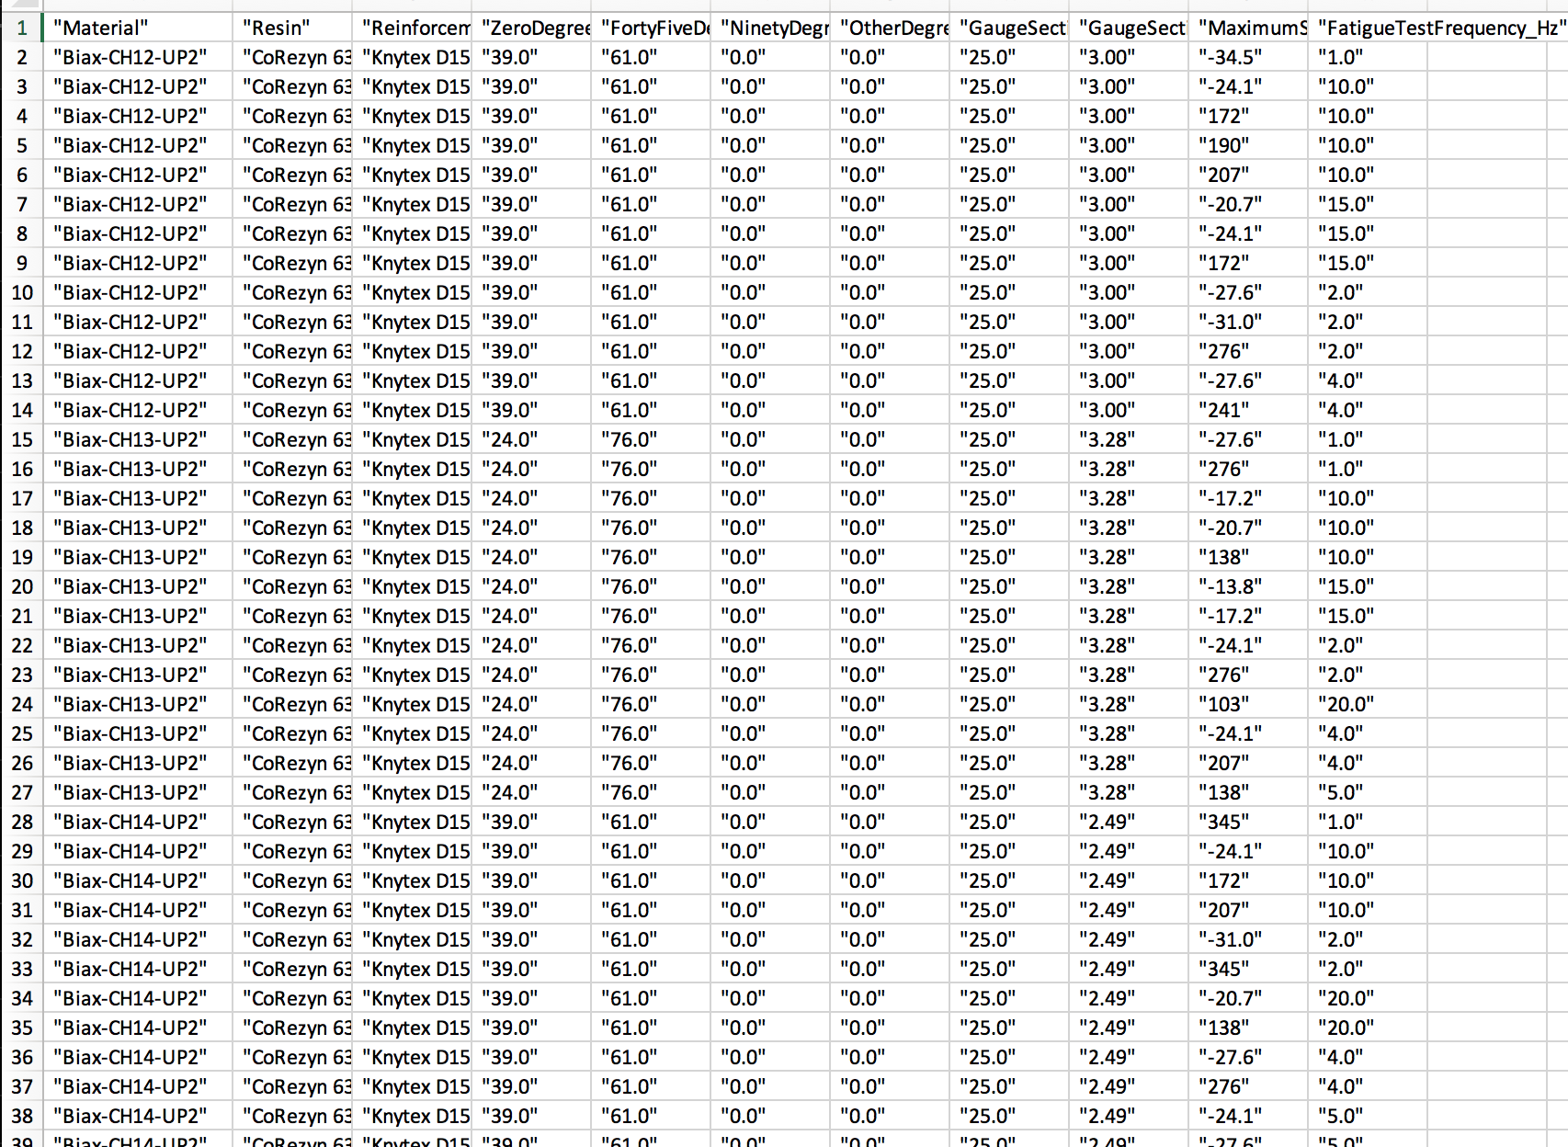
Query 1 Results
Take away: Holding fixed the combination of values in the red box, see the combination of maximum stress and fatigue test frequencies in the blue box.

Slide 25
Query 1a
PREFIX emae06: <http://example.com/emae06#>
PREFIX xsd: <http://www.w3.org/2001/XMLSchema#>
SELECT DISTINCT ?Material ?Resin ?ReinforcementFiber ?ZeroDegreeDirectionFiber_pct ?FortyFiveDegreeDirectionFiber_pct ?NinetyDegreeDirectionFiber_pct ?OtherDegreeDirectionFiber_pct ?GaugeSectionWidth_mm ?GaugeSectionThickness_mm ?MaximumStress_MPa ?FatigueTestFrequency_Hz
WHERE {
?a emae06:sshAstmLayup "[(+-45/0):3]:s" .
?a emae06:sshUsesMaterial ?Material .
?a emae06:sshResin ?Resin .
?a emae06:sshZeroDegreeReinforcementFabric ?ReinforcementFiber .
?a emae06:sshPctInZeroDegDirection ?ZeroDegreeDirectionFiber_pct .
?a emae06:sshPctInFortyFiveDegreeDirection ?FortyFiveDegreeDirectionFiber_pct .
?a emae06:sshPctInNinetyDegreeDirection ?NinetyDegreeDirectionFiber_pct .
?a emae06:sshPctInOtherDirection ?OtherDegreeDirectionFiber_pct .
?a emae06:sshGaugeSectionThickness ?GaugeSectionThickness_mm .
?a emae06:sshGageSectionWidth ?GaugeSectionWidth_mm .
?a emae06:sshMaxStress ?MaximumStress_MPa .
?a emae06:sshFatigueTestFrequency ?FatigueTestFrequency_Hz
}
ORDER BY ?Material ?Resin ?ReinforcementFiber ?ZeroDegreeDirectionFiber_pct ?FortyFiveDegreeDirectionFiber_pct ?NinetyDegreeDirectionFiber_pct ?OtherDegreeDirectionFiber_pct ?GaugeSectionWidth_mm ?GaugeSectionThickness_mm

Slide 26
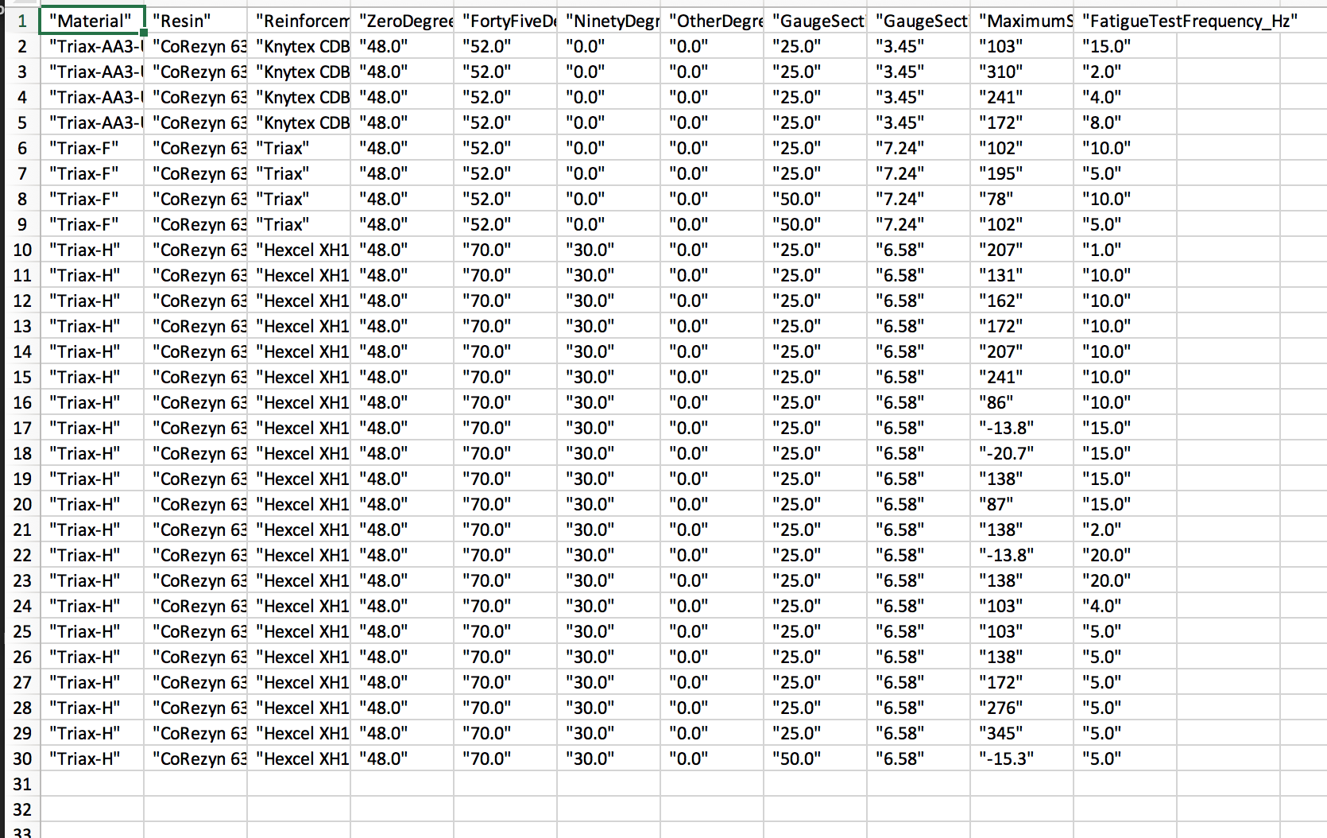
Query 1a - Results

Slide 27
Query 1b
PREFIX emae06: <http://example.com/emae06#>
PREFIX xsd: <http://www.w3.org/2001/XMLSchema#>
SELECT DISTINCT ?Resin ?ReinforcementFiber ?ZeroDegreeDirectionFiber_pct ?FortyFiveDegreeDirectionFiber_pct ?NinetyDegreeDirectionFiber_pct ?OtherDegreeDirectionFiber_pct ?GaugeSectionWidth_mm ?GaugeSectionThickness_mm ?MaximumStress_MPa ?FatigueTestFrequency_Hz
WHERE {
?a emae06:sshUsesMaterial "UNI-A" .
?a emae06:sshResin ?Resin .
?a emae06:sshZeroDegreeReinforcementFabric ?ReinforcementFiber .
?a emae06:sshPctInZeroDegDirection ?ZeroDegreeDirectionFiber_pct .
?a emae06:sshPctInFortyFiveDegreeDirection ?FortyFiveDegreeDirectionFiber_pct .
?a emae06:sshPctInNinetyDegreeDirection ?NinetyDegreeDirectionFiber_pct .
?a emae06:sshPctInOtherDirection ?OtherDegreeDirectionFiber_pct .
?a emae06:sshGaugeSectionThickness ?GaugeSectionThickness_mm .
?a emae06:sshGageSectionWidth ?GaugeSectionWidth_mm .
?a emae06:sshMaxStress ?MaximumStress_MPa .
?a emae06:sshFatigueTestFrequency ?FatigueTestFrequency_Hz
}
ORDER BY ?Resin ?ReinforcementFiber ?ZeroDegreeDirectionFiber_pct ?FortyFiveDegreeDirectionFiber_pct ?NinetyDegreeDirectionFiber_pct ?OtherDegreeDirectionFiber_pct ?GaugeSectionWidth_mm ?GaugeSectionThickness_mm

Slide 28
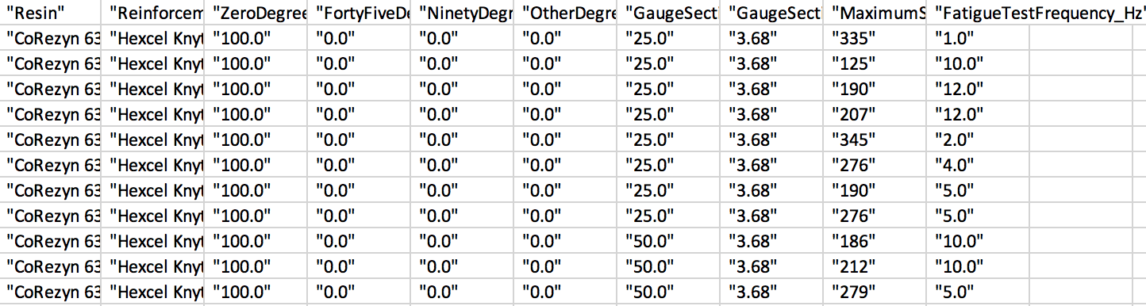
Query 1b

Slide 29
SPARQL Query 2
Wind Turbine Project
According to the material type, its properties, and the specimen’s dimensions, find the variation of the maximum strain percentage and the load cycle time applied to the specimen.
Query 1a: Filter the search by the material’s layer structure
Query 1b: Filter the search by the material’s name

Slide 30
Query 2
PREFIX emae06: <http://example.com/emae06#>
PREFIX xsd: <http://www.w3.org/2001/XMLSchema#>
SELECT DISTINCT ?Material ?Resin ?ReinforcementFiber ?ZeroDegreeDirectionFiber_pct ?FortyFiveDegreeDirectionFiber_pct ?NinetyDegreeDirectionFiber_pct ?OtherDegreeDirectionFiber_pct ?GaugeSectionWidth_mm ?GaugeSectionThickness_mm ?MaximumStrain_pct ?LoadCycle_time
WHERE {
?a emae06:sshUsesMaterial ?Material .
?a emae06:sshResin ?Resin .
?a emae06:sshZeroDegreeReinforcementFabric ?ReinforcementFiber .
?a emae06:sshPctInZeroDegDirection ?ZeroDegreeDirectionFiber_pct .
?a emae06:sshPctInFortyFiveDegreeDirection ?FortyFiveDegreeDirectionFiber_pct .
?a emae06:sshPctInNinetyDegreeDirection ?NinetyDegreeDirectionFiber_pct .
?a emae06:sshPctInOtherDirection ?OtherDegreeDirectionFiber_pct .
?a emae06:sshGaugeSectionThickness ?GaugeSectionThickness_mm .
?a emae06:sshGageSectionWidth ?GaugeSectionWidth_mm .
?a emae06:sshMaxStrainPct ?MaximumStrain_pct .
?a emae06:sshAppliedMechanicalLoadCycles ?LoadCycle_time
}
ORDER BY ?Material ?Resin ?ReinforcementFiber ?ZeroDegreeDirectionFiber_pct ?FortyFiveDegreeDirectionFiber_pct ?NinetyDegreeDirectionFiber_pct ?OtherDegreeDirectionFiber_pct ?GaugeSectionWidth_mm ?GaugeSectionThickness_mm

Slide 31
Query 2a
PREFIX emae06: <http://example.com/emae06#>
PREFIX xsd: <http://www.w3.org/2001/XMLSchema#>
SELECT DISTINCT ?Material ?Resin ?ReinforcementFiber ?ZeroDegreeDirectionFiber_pct ?FortyFiveDegreeDirectionFiber_pct ?NinetyDegreeDirectionFiber_pct ?OtherDegreeDirectionFiber_pct ?GaugeSectionWidth_mm ?GaugeSectionThickness_mm ?MaximumStrain_pct ?LoadCycle_time
WHERE {
?a emae06:sshAstmLayup "[(+-45/0):3]:s" .
?a emae06:sshUsesMaterial ?Material .
?a emae06:sshResin ?Resin .
?a emae06:sshZeroDegreeReinforcementFabric ?ReinforcementFiber .
?a emae06:sshPctInZeroDegDirection ?ZeroDegreeDirectionFiber_pct .
?a emae06:sshPctInFortyFiveDegreeDirection ?FortyFiveDegreeDirectionFiber_pct .
?a emae06:sshPctInNinetyDegreeDirection ?NinetyDegreeDirectionFiber_pct .
?a emae06:sshPctInOtherDirection ?OtherDegreeDirectionFiber_pct .
?a emae06:sshGaugeSectionThickness ?GaugeSectionThickness_mm .
?a emae06:sshGageSectionWidth ?GaugeSectionWidth_mm .
?a emae06:sshMaxStrainPct ?MaximumStrain_pct .
?a emae06:sshAppliedMechanicalLoadCycles ?LoadCycle_time
}
ORDER BY ?Material ?Resin ?ReinforcementFiber ?ZeroDegreeDirectionFiber_pct ?FortyFiveDegreeDirectionFiber_pct ?NinetyDegreeDirectionFiber_pct ?OtherDegreeDirectionFiber_pct ?GaugeSectionWidth_mm ?GaugeSectionThickness_mm

Slide 32
Query 2b
PREFIX emae06: <http://example.com/emae06#>
PREFIX xsd: <http://www.w3.org/2001/XMLSchema#>
SELECT DISTINCT ?Resin ?ReinforcementFiber ?ZeroDegreeDirectionFiber_pct ?FortyFiveDegreeDirectionFiber_pct ?NinetyDegreeDirectionFiber_pct ?OtherDegreeDirectionFiber_pct ?GaugeSectionWidth_mm ?GaugeSectionThickness_mm ?MaximumStrain_pct ?LoadCycle_time
WHERE {
?a emae06:sshUsesMaterial "UNI-A" .
?a emae06:sshResin ?Resin .
?a emae06:sshZeroDegreeReinforcementFabric ?ReinforcementFiber .
?a emae06:sshPctInZeroDegDirection ?ZeroDegreeDirectionFiber_pct .
?a emae06:sshPctInFortyFiveDegreeDirection ?FortyFiveDegreeDirectionFiber_pct .
?a emae06:sshPctInNinetyDegreeDirection ?NinetyDegreeDirectionFiber_pct .
?a emae06:sshPctInOtherDirection ?OtherDegreeDirectionFiber_pct .
?a emae06:sshGaugeSectionThickness ?GaugeSectionThickness_mm .
?a emae06:sshGageSectionWidth ?GaugeSectionWidth_mm .
?a emae06:sshMaxStrainPct ?MaximumStrain_pct .
?a emae06:sshAppliedMechanicalLoadCycles ?LoadCycle_time
}
ORDER BY ?Resin ?ReinforcementFiber ?ZeroDegreeDirectionFiber_pct ?FortyFiveDegreeDirectionFiber_pct ?NinetyDegreeDirectionFiber_pct ?OtherDegreeDirectionFiber_pct ?GaugeSectionWidth_mm ?GaugeSectionThickness_mm

Slide 33
SPARQL QUERY 3
Wind Turbine Project
According to the material type, its properties, and also the specimen’s dimensions, find the variation of the stress ratio (min stress/max stress) and the load cycle time applied to the specimen.
Query 1a: Filter the search by the material’s layer structure
Query 1b: Filter the search by the material’s name

Slide 34
Query 3
PREFIX emae06: <http://example.com/emae06#>
PREFIX xsd: <http://www.w3.org/2001/XMLSchema#>
SELECT DISTINCT ?Material ?Resin ?ReinforcementFiber ?ZeroDegreeDirectionFiber_pct ?FortyFiveDegreeDirectionFiber_pct ?NinetyDegreeDirectionFiber_pct ?OtherDegreeDirectionFiber_pct ?GaugeSectionWidth_mm ?GaugeSectionThickness_mm ?MaximumStrain_pct ?StressRatio ?LoadCycle_time
WHERE {
?a emae06:sshUsesMaterial ?Material .
?a emae06:sshResin ?Resin .
?a emae06:sshZeroDegreeReinforcementFabric ?ReinforcementFiber .
?a emae06:sshPctInZeroDegDirection ?ZeroDegreeDirectionFiber_pct .
?a emae06:sshPctInFortyFiveDegreeDirection ?FortyFiveDegreeDirectionFiber_pct .
?a emae06:sshPctInNinetyDegreeDirection ?NinetyDegreeDirectionFiber_pct .
?a emae06:sshPctInOtherDirection ?OtherDegreeDirectionFiber_pct .
?a emae06:sshGaugeSectionThickness ?GaugeSectionThickness_mm .
?a emae06:sshGageSectionWidth ?GaugeSectionWidth_mm .
?a emae06:sshMaxStrainPct ?MaximumStrain_pct .
?a emae06:sshStressRatio ?StressRatio .
?a emae06:sshAppliedMechanicalLoadCycles ?LoadCycle_time
}
ORDER BY ?Material ?Resin ?ReinforcementFiber ?ZeroDegreeDirectionFiber_pct ?FortyFiveDegreeDirectionFiber_pct ?NinetyDegreeDirectionFiber_pct ?OtherDegreeDirectionFiber_pct ?GaugeSectionWidth_mm ?GaugeSectionThickness_mm

Slide 35
Query 3a
PREFIX emae06: <http://example.com/emae06#>
PREFIX xsd: <http://www.w3.org/2001/XMLSchema#>
SELECT DISTINCT ?Material ?Resin ?ReinforcementFiber ?ZeroDegreeDirectionFiber_pct ?FortyFiveDegreeDirectionFiber_pct ?NinetyDegreeDirectionFiber_pct ?OtherDegreeDirectionFiber_pct ?GaugeSectionWidth_mm ?GaugeSectionThickness_mm ?MaximumStrain_pct ?StressRatio ?LoadCycle_time
WHERE {
?a emae06:sshAstmLayup "[(+-45/0):3]:s" .
?a emae06:sshUsesMaterial ?Material .
?a emae06:sshResin ?Resin .
?a emae06:sshZeroDegreeReinforcementFabric ?ReinforcementFiber .
?a emae06:sshPctInZeroDegDirection ?ZeroDegreeDirectionFiber_pct .
?a emae06:sshPctInFortyFiveDegreeDirection ?FortyFiveDegreeDirectionFiber_pct .
?a emae06:sshPctInNinetyDegreeDirection ?NinetyDegreeDirectionFiber_pct .
?a emae06:sshPctInOtherDirection ?OtherDegreeDirectionFiber_pct .
?a emae06:sshGaugeSectionThickness ?GaugeSectionThickness_mm .
?a emae06:sshGageSectionWidth ?GaugeSectionWidth_mm .
?a emae06:sshMaxStrainPct ?MaximumStrain_pct .
?a emae06:sshStressRatio ?StressRatio .
?a emae06:sshAppliedMechanicalLoadCycles ?LoadCycle_time
}
ORDER BY ?Material ?Resin ?ReinforcementFiber ?ZeroDegreeDirectionFiber_pct ?FortyFiveDegreeDirectionFiber_pct ?NinetyDegreeDirectionFiber_pct ?OtherDegreeDirectionFiber_pct ?GaugeSectionWidth_mm ?GaugeSectionThickness_mm

Slide 36
Query 3b
PREFIX emae06: <http://example.com/emae06#>
PREFIX xsd: <http://www.w3.org/2001/XMLSchema#>
SELECT DISTINCT ?Resin ?ReinforcementFiber ?ZeroDegreeDirectionFiber_pct ?FortyFiveDegreeDirectionFiber_pct ?NinetyDegreeDirectionFiber_pct ?OtherDegreeDirectionFiber_pct ?GaugeSectionWidth_mm ?GaugeSectionThickness_mm ?MaximumStrain_pct ?StressRatio ?LoadCycle_time
WHERE {
?a emae06:sshUsesMaterial "UNI-A" .
?a emae06:sshResin ?Resin .
?a emae06:sshZeroDegreeReinforcementFabric ?ReinforcementFiber .
?a emae06:sshPctInZeroDegDirection ?ZeroDegreeDirectionFiber_pct .
?a emae06:sshPctInFortyFiveDegreeDirection ?FortyFiveDegreeDirectionFiber_pct .
?a emae06:sshPctInNinetyDegreeDirection ?NinetyDegreeDirectionFiber_pct .
?a emae06:sshPctInOtherDirection ?OtherDegreeDirectionFiber_pct .
?a emae06:sshGaugeSectionThickness ?GaugeSectionThickness_mm .
?a emae06:sshGageSectionWidth ?GaugeSectionWidth_mm .
?a emae06:sshMaxStrainPct ?MaximumStrain_pct .
?a emae06:sshStressRatio ?StressRatio .
?a emae06:sshAppliedMechanicalLoadCycles ?LoadCycle_time
}
ORDER BY ?Resin ?ReinforcementFiber ?ZeroDegreeDirectionFiber_pct ?FortyFiveDegreeDirectionFiber_pct ?NinetyDegreeDirectionFiber_pct ?OtherDegreeDirectionFiber_pct ?GaugeSectionWidth_mm ?GaugeSectionThickness_mm

Slide 37
Wind Turbine Project
One Idea for Achieving Commercial Viability
Create a Web Form wrapped around a SPARQL endpoint using our terms.
Point the Web Form to a SPARQL Engine with an RDF backend.

Slide 38
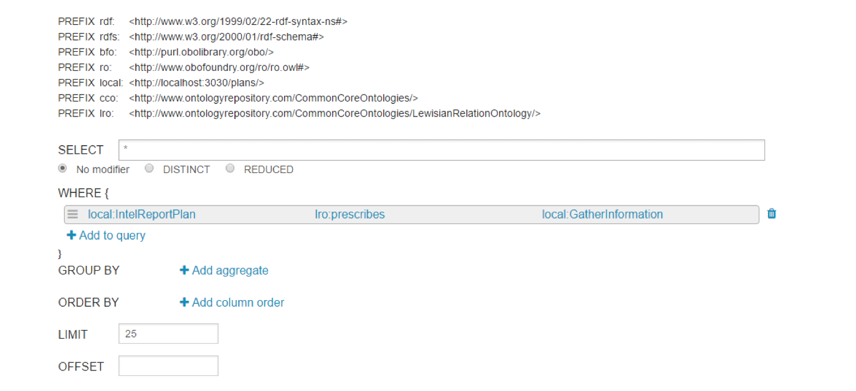
Wind Turbine Project
A SPARQL endpoint is too complicated or casual users

Slide 39
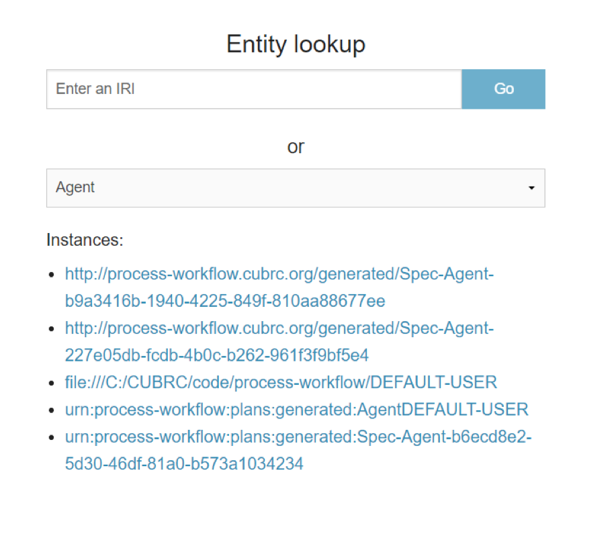
Wind Turbine Project
Process Workflow

Slide 40
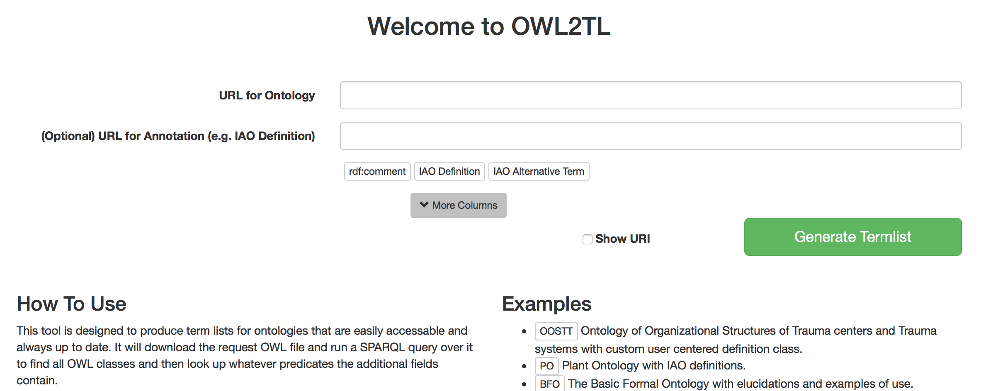
Wind Turbine Project
OWL2TL

Slide 41
Wind Turbine Project
Material Analysis Query Portal
Key Performance Parameter
Key Design Objective
How to Use
Example
Using the drop-down menu, specify the key performance parameters that will constrain your search. Then specify the key design objective you are looking for. The portal will then build a SPARQL query on the backend to query the Sandia Labs Knowledge graph and find your optimal results
Key Performance Parameters: Beam Weight, I-Beam structure, Fatigue Test Frequency of less than 50hrz
Key Design Objective: Material Type and Resign Type

Slide 42
Wind Turbine Project
Tools to Explore
The Product Life Cycle Ontologies and Semantic Web Tools are available here:
https://github.com/NCOR-US/CHAMP
The Common Core Ontologies are available here:
https://github.com/CommonCoreOntology
Basic Formal Ontology 2.0 and the Relations Ontology (RO) is available here:
https://github.com/BFO-ontology
TopBraid will be used for ontology creation and ingestion:
https://www.topquadrant.com/tools/ide-topbraid-composer-maestro-edition/

Slide 43
Wind Turbine Project
Deliverables
All final deliverables are available on github here:
https://github.com/NCOR-US/WindTurbineProject
These include:
Final Report
Application Ontology (wtba.ttl) and links to its imported ontologies
RDF knowledge graph
Instructions for creating RDF using our methods
Instructions for running the knowledge graph on a server
Slide deck
Sample SPARQL queries
Links to open-source tools used during the project

Slide 44
Wind Turbine Project
Thanks to DMDII

